Slide 1
Greenhouse Gas Contributors and Predictions
Regis University
MSDS 692 Practicum 1 Quinn Maloney

Slide 2
Project Overview
Background
Problem Description/ Project Motivation
Data Overview
Analysis
Findings
Future steps

Slide 3
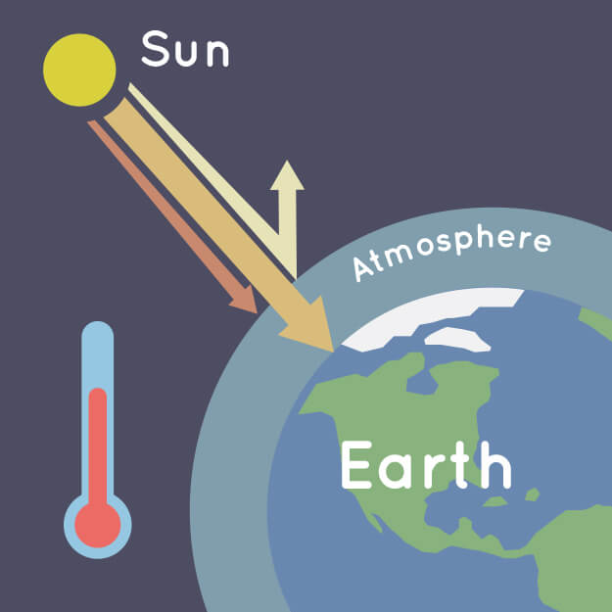
Background Information: Greenhouse Gases & Why We Should Care.
The main gases responsible for the greenhouse effect include:
Carbon Dioxide (co2)
Methane
Nitrous Oxide
Water Vapor
Fluorinated gases (which are synthetic)

Slide 4
Problem Description/ Project Motivation
Motivation: Climate change is a very real crisis we are facing today and human emissions of co2 and other greenhouse gasses are a primary driver of climate change.
Goal: My goal for this practicum project is to determine the main contributors to greenhouse gas emissions and make future emission predictions. Additionally, in order to effectively reduce emissions, it is important to figure out where these emissions are coming from.
Study Questions:
Is there a trend in the release of global greenhouse gases and can we correlate this to human actions?
Where are these emissions coming from?
Can we predict future emission values for years 2021-2026?

Slide 5
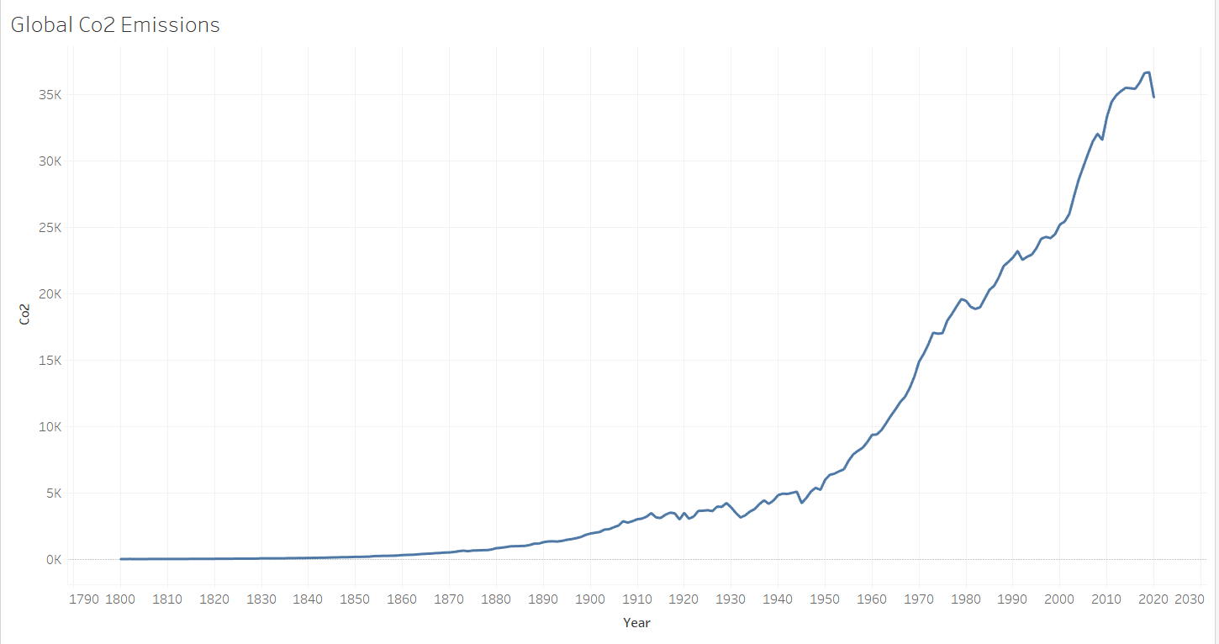
Human Contribution
The increase in global Carbon Dioxide emissions beginning with the Industrial Revolution (1760-1840) suggests to us that humans have increased the emissions of greenhouse gases through the burning of fossil fuels such as coal and oil which release carbon dioxide into the atmosphere. These extra greenhouse gasses have caused the atmosphere to trap more and more heat which is overall warming the planet.
The figure above represents global co2 emission values, measured in million tonnes from 1800 to 2020.

Slide 6
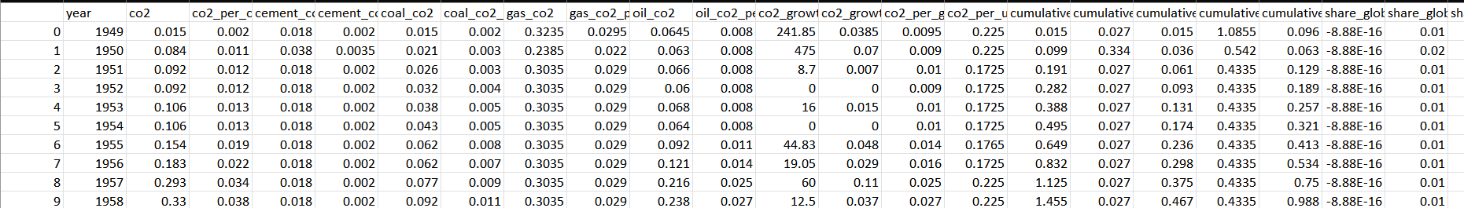
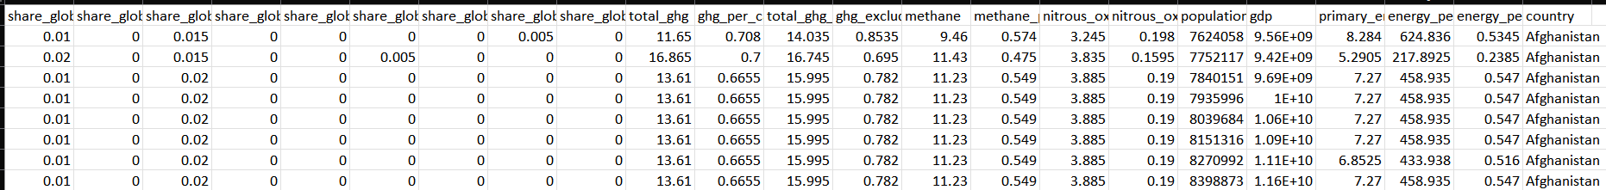
Data Description
Data size: before cleaning (60 columns, 25,989 rows), after cleaning (44 columns, 25,989 rows)
Data Set: includes country emission values from late 1700’s to 2020
Data Types: Float(emissions values), Int (year), Categorical (country)
Feature Importance?

Slide 7
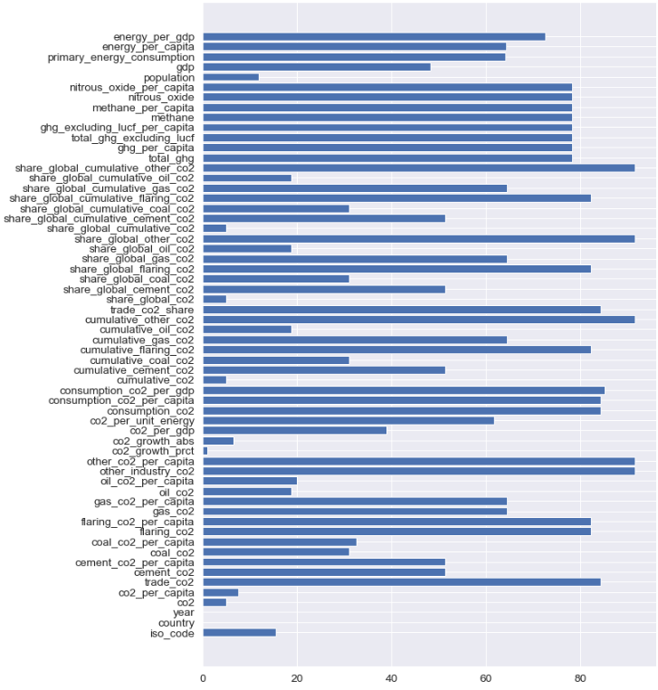
Missing Data

Slide 8
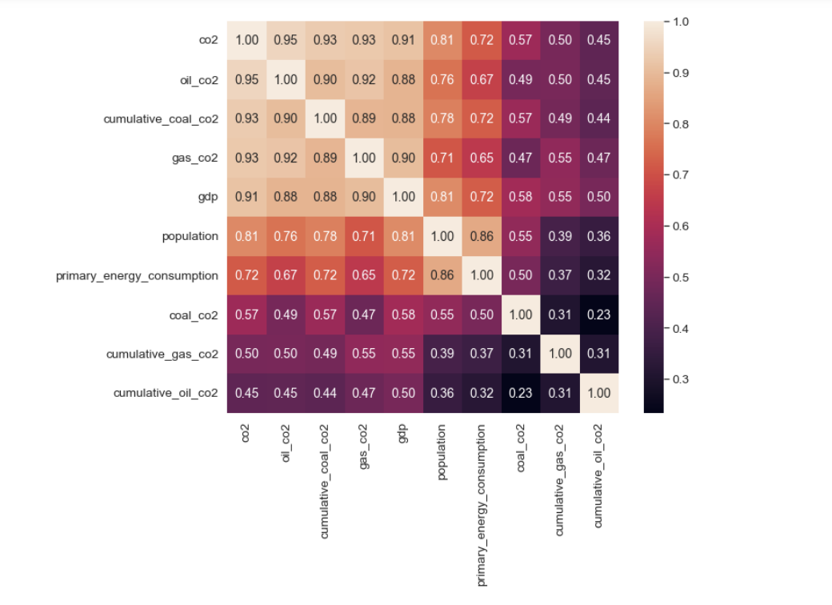
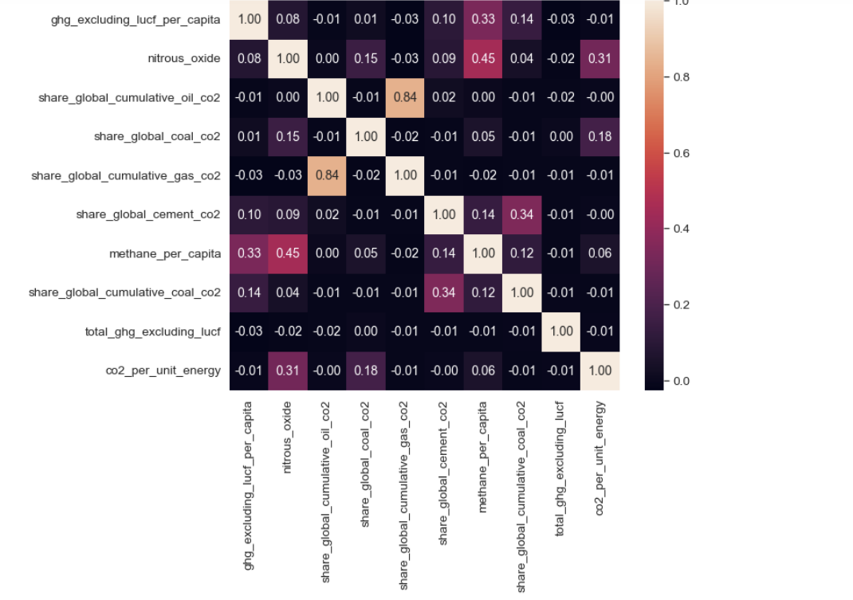
Data Exploration (EDA) & Feature Importance
10 most positively correlated columns to co2 (Pearsons Correlation) 10 largest negatively correlated columns to co2 (Pearsons Correlation)

Slide 9
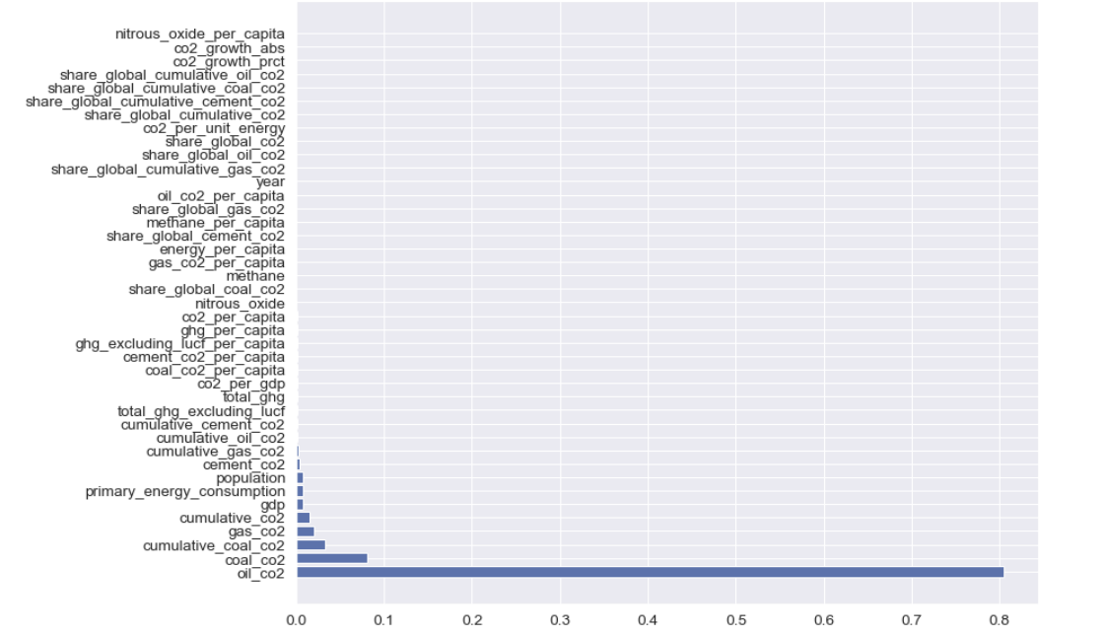
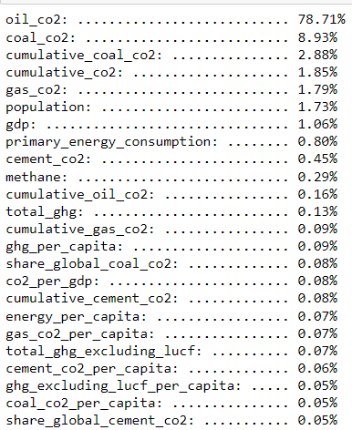
Feature Importance

Slide 10
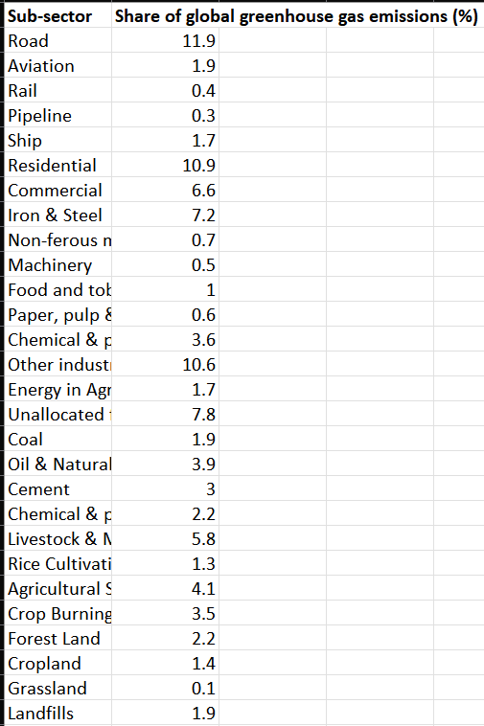
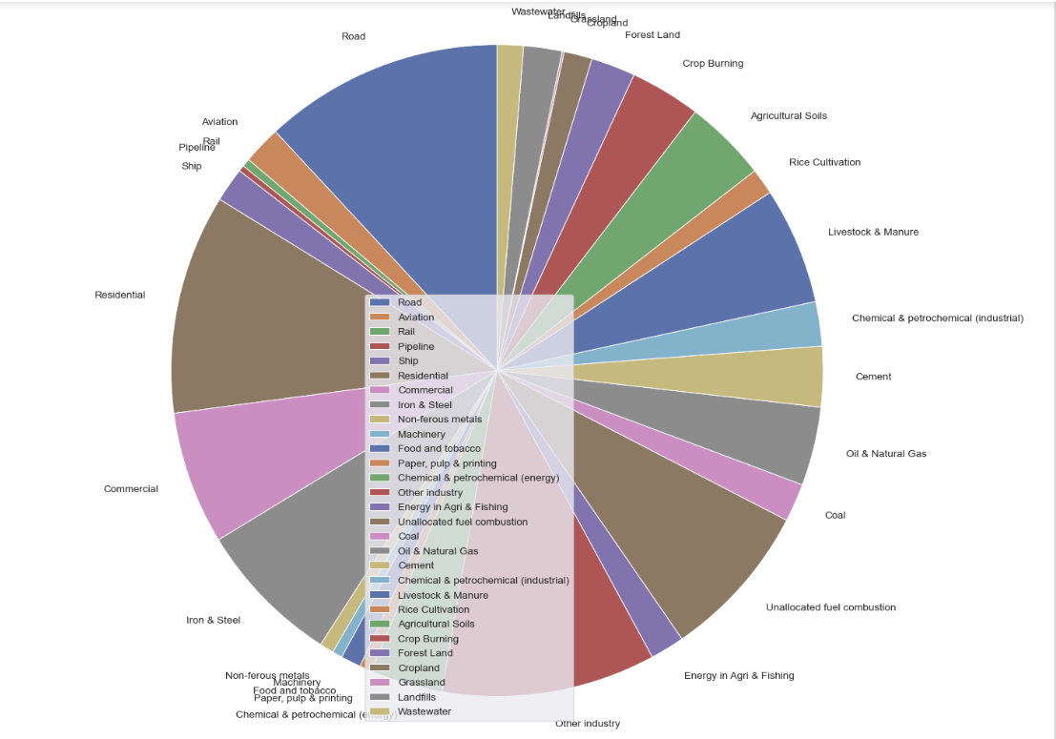
Emissions by Sector Dataset
Share of global greenhouse gas emissions(%) for each sub-sector in the year 2020

Slide 11
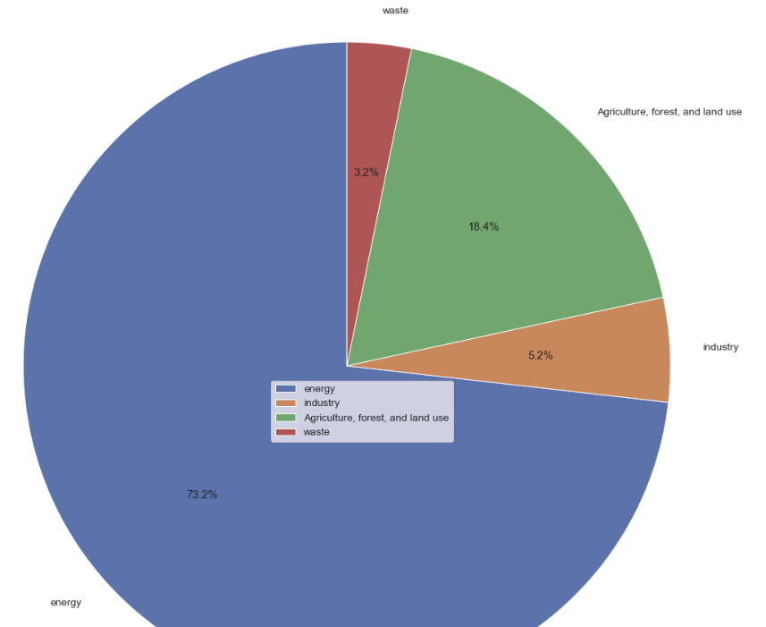
From the previous dataset, I further categorized the data into one of the following subsectors: 'energy', 'industry', 'Agriculture, forest, and land use' or 'waste'.
The figure shows that:
73.2% of all greenhouse gas emissions are from energy production
18.4% of all greenhouse gas emissions are from Agriculture, forest, and land use production
5.2% of all greenhouse gas emissions are from industry production
3.2% of all greenhouse gas emissions are from waste production

Slide 12
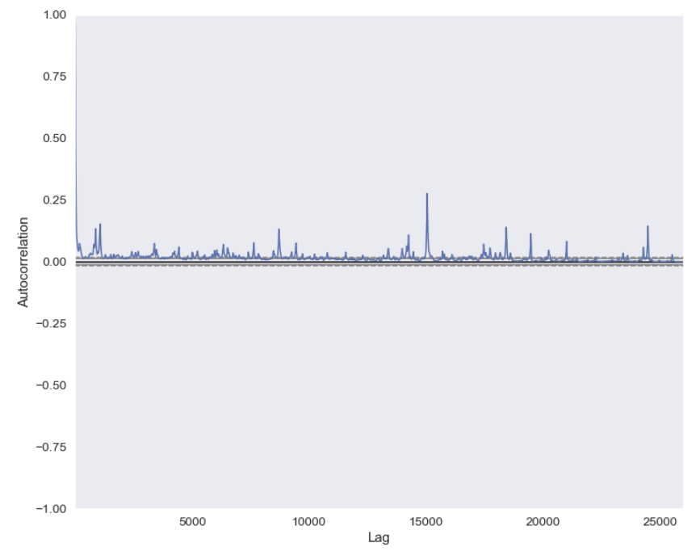
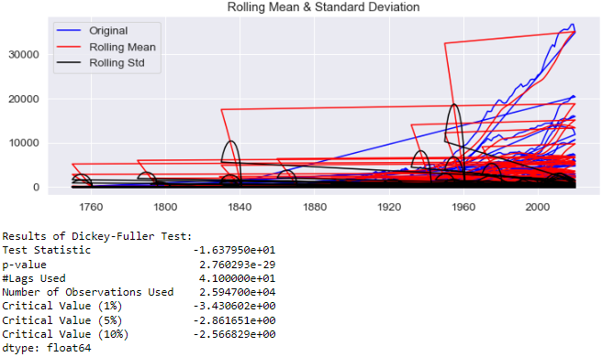
Analysis Plan
Time Series Forecast: predicting future co2 values using time series modeling
Checking stationarity for our co2 column
The figure above shows that our data was not stationary because mean is increasing even though the std is small, and Test stat is > critical value.

Slide 13
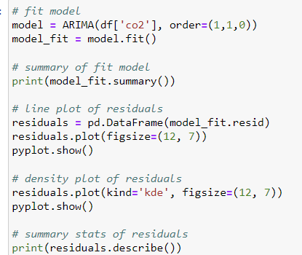
ARIMA time series forecasting model (p, d, q)
ARIMA(1, 1, 0): differenced first-order autoregressive model.
Prediction equation:
Ŷ_{t} - Y_{t-1} = μ + ϕ₁(Y_{t-1} - Y_{t-2})
Ŷ_{t} - Y_{t-1} = μ
which can be rearranged to
Ŷ_{t} = μ + Y_{t-1} + ϕ₁ (Y_{t-1} - Y_{t-2})
ARIMA(1, 1, 0) is a first-order autoregressive model with
one order of nonseasonal differencing and a constant term.

Slide 14
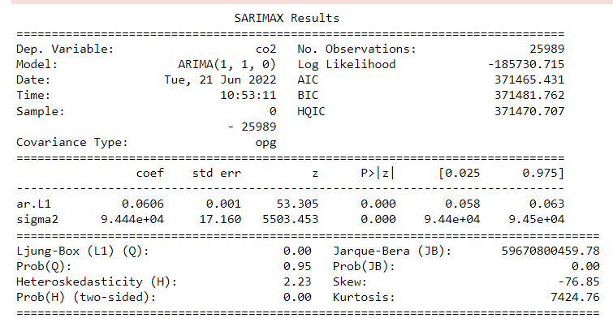
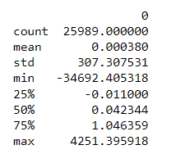
Results after fitting our ARIMA(1, 1, 0) model.
The P-Value in ‘P>|z|’ column should ideally be less than 0.05 for the model to be significant.

Slide 15
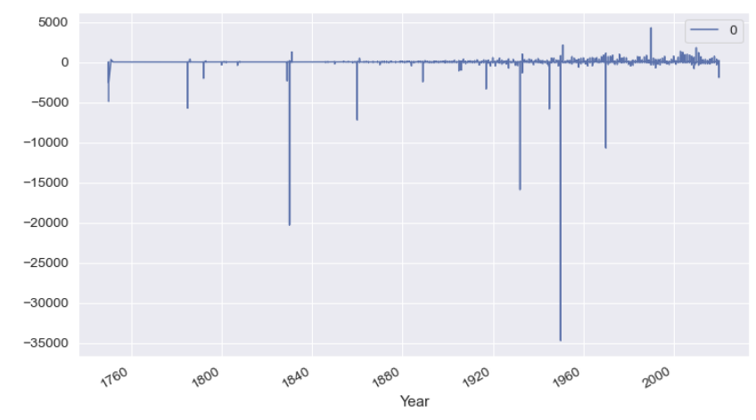
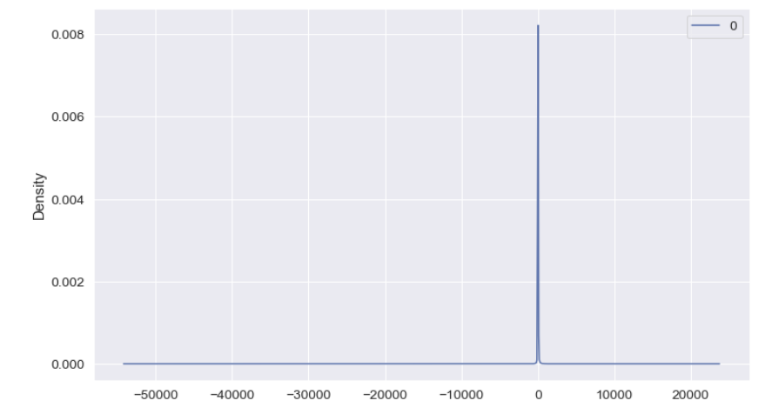
We can see from our second plot below that our errors are Guassian and may be centered at 0.
Results from fitting our ARIMA model cont…
Our first plot above is showing a line plot of the residual errors. The results show that indeed there is a slight bias in the prediction (a non-zero mean in the residuals).

Slide 16
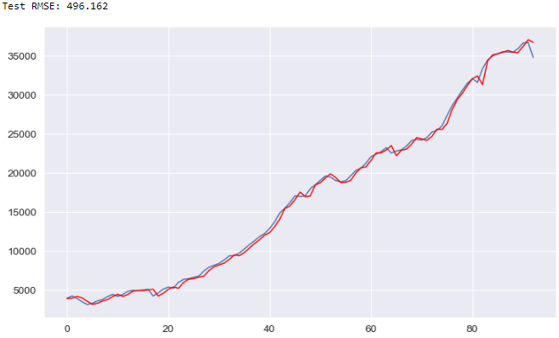
Results from fitting our ARIMA model cont…
This figure shows the expected co2 values from the dataset in blue and the predicted value from the model in red. The figure is only for 'World'.

Slide 17
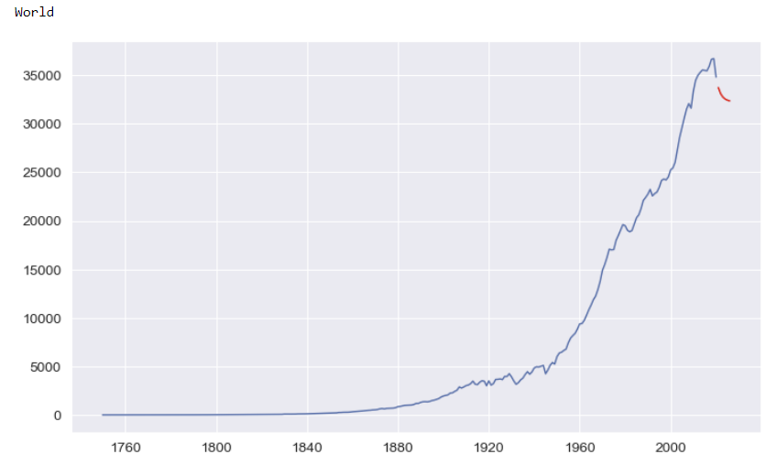
Time Series Results: Co2 values for years 2021-2026
Co2 emission values for World are provided in blue while prediction values for 2021-2026 are provided in red.

Slide 18
Conclusions
We can see that there is a correlation between human production and emission rates.
We have found that energy production(accounting for 73.2% of all global greenhouse gas emissions) is the largest sector emitting these greenhouse gasses.
We are able to make predictions for future emission rates based on previous trends.

Slide 19
Next Steps
Complete ARIMA time series predictions for years 2021-2026 on ‘cement_co2', 'coal_co2', 'gas_co2', 'oil_co2', 'nitrous_oxide', and 'methane' columns
Compare predicted results with actual values as the years go on.
Discover solutions to reduce emission rates
Discover more factors which lead to the increase or decrease in emission rates.

Slide 20
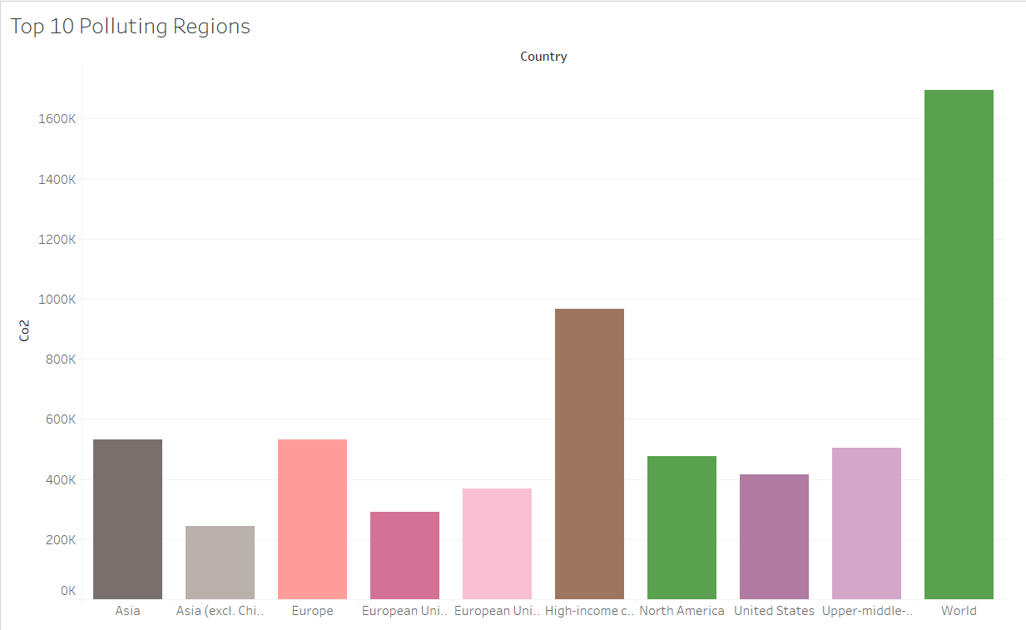
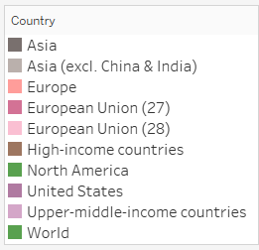
Interesting Findings

Slide 21
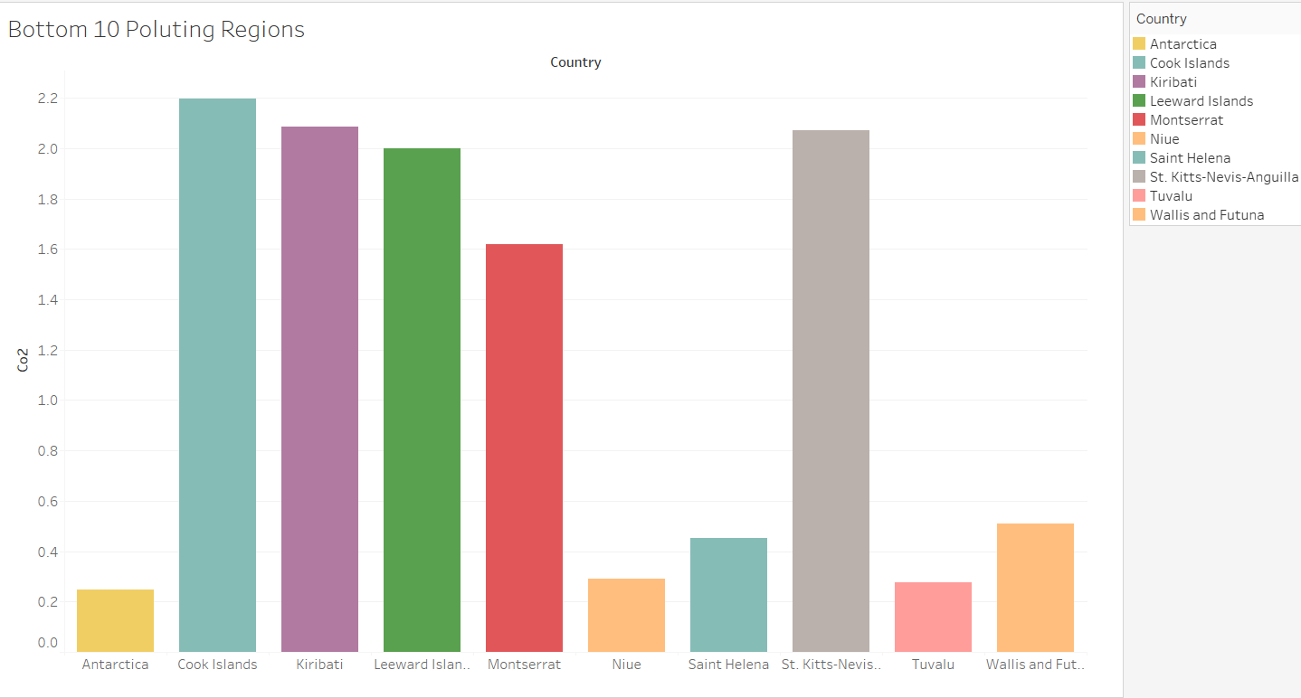
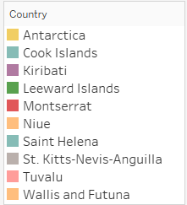

Slide 22
Thank You!

